Slide 1
REVISION
DATA MANIPULATION AND CONSIDERING DATABASE NEEDS

Slide 2




Do Now Activity (5 mins)
What SQL keyword do you use to specify the columns you want to retrieve (e.g., FirstName, Email)?
What SQL keyword do you use to specify the table you want to get data from?
Write the complete SQL query to select only the Productname and Price from a single table named Products.
TOK
To what extent can data manipulation be considered an objective process when human judgment influences how databases are designed and interpreted?
Learning Intention: To learn how to retrieve and modify data from related tables using INSERT , UPDATE & DELETE
Success Criteria:
I can identify the Primary Key and Foreign Key that link the table
I can write a SELECT statement that uses update /insert

Slide 3
UAE Link / UAE Context Question
Link to UAE:
Data manipulation and database design are key parts of the UAE’s digital transformation strategy — especially under initiatives like UAE Digital Government Strategy 2025 and Smart Dubai.
UAE Question:
How do initiatives like Smart Dubai or UAE Pass use data manipulation and database management to improve public services and citizen experience?
Possible references:
https://u.ae/en/about-the-uae/digital-uae
https://smartdubai.ae
Interdisciplinary Question:
How can mathematical logic and ethical considerations combine when designing and manipulating databases for business or government use?
Real-life Question:
How does effective data manipulation support accurate decision-making in UAE businesses and government institutions?
Learning Intention: To learn how to retrieve and modify data from related tables using INSERT , UPDATE & DELETE
Success Criteria:
I can identify the Primary Key and Foreign Key that link the table
I can write a SELECT statement that uses update /insert

Slide 4
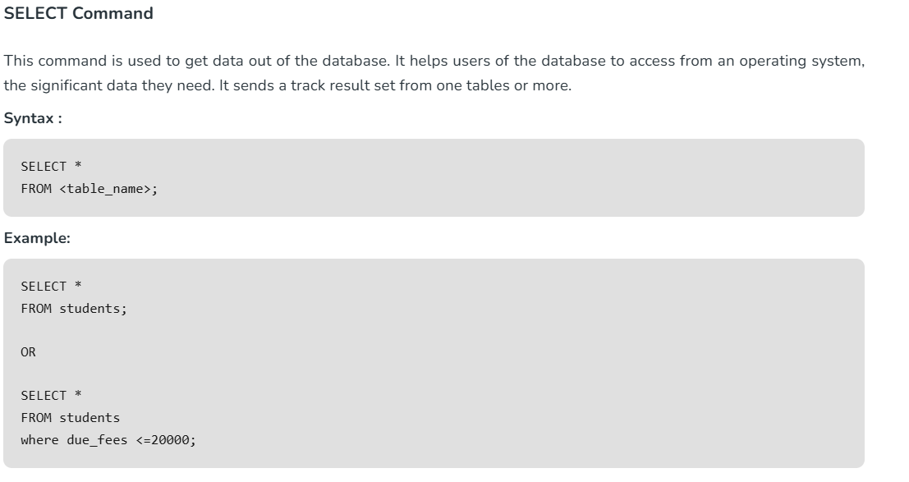
Learning Intention: To learn how to retrieve and modify data from related tables using INSERT , UPDATE & DELETE
Success Criteria:
I can identify the Primary Key and Foreign Key that link the table
I can write a SELECT statement that uses update /insert

Slide 5
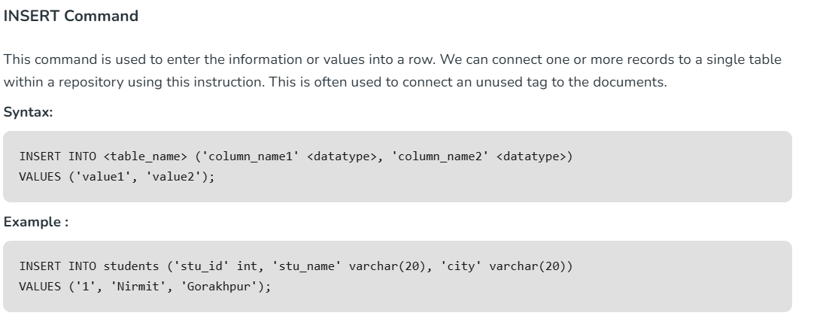
Learning Intention: To learn how to retrieve and modify data from related tables using INSERT , UPDATE & DELETE
Success Criteria:
I can identify the Primary Key and Foreign Key that link the table
I can write a SELECT statement that uses update /insert

Slide 6
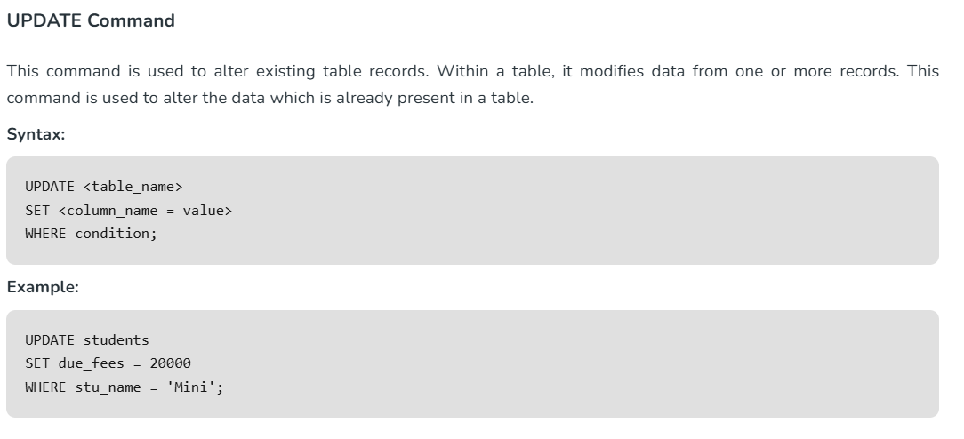
Learning Intention: To learn how to retrieve and modify data from related tables using INSERT , UPDATE & DELETE
Success Criteria:
I can identify the Primary Key and Foreign Key that link the table
I can write a SELECT statement that uses update /insert

Slide 7
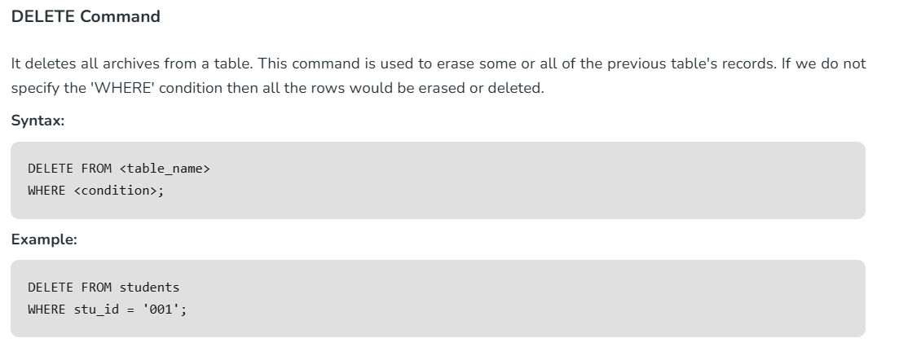
Learning Intention: To learn how to retrieve and modify data from related tables using INSERT , UPDATE & DELETE
Success Criteria:
I can identify the Primary Key and Foreign Key that link the table
I can write a SELECT statement that uses update /insert

Slide 8
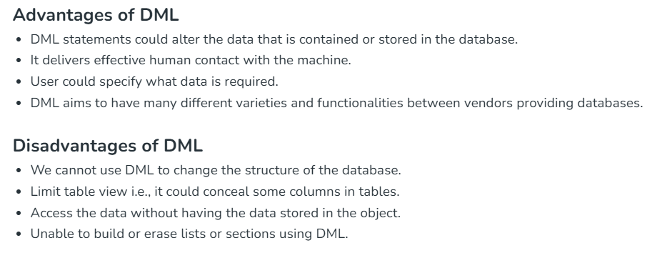
Learning Intention: To learn how to retrieve and modify data from related tables using INSERT , UPDATE & DELETE
Success Criteria:
I can identify the Primary Key and Foreign Key that link the table
I can write a SELECT statement that uses update /insert

Slide 9
STUDENTS WORKING ON THE WORKSHEET CHALLENGES
Learning Intention: To learn how to retrieve and modify data from related tables using INSERT , UPDATE & DELETE
Success Criteria:
I can identify the Primary Key and Foreign Key that link the table
I can write a SELECT statement that uses update /insert

Slide 10
🟢
What does the INSERT command do in a database?
Write an SQL statement to add a new record for a student named “Ali Khan” with ID 110.
What could happen if you forget to include the WHERE clause in an UPDATE or DELETE command?
Why is it important to check data types before inserting new values?
Learning Intention: To learn how to retrieve and modify data from related tables using INSERT , UPDATE & DELETE
Success Criteria:
I can identify the Primary Key and Foreign Key that link the table
I can write a SELECT statement that uses update /insert

Slide 11
🟡
Write SQL commands to:
  Add a new student (StudentID=120, FirstName='Mariam', LastName='Omar', AdvisorID=25).
  Update Mariam’s AdvisorID to 30.
  Delete Mariam’s record afterward.
Explain how the UPDATE and DELETE commands can affect data integrity if used incorrectly.
How can database permissions help prevent accidental data loss?
Give one example from the UAE context (e.g., Smart Dubai, UAE PASS) where data manipulation helps improve citizen services.
Learning Intention: To learn how to retrieve and modify data from related tables using INSERT , UPDATE & DELETE
Success Criteria:
I can identify the Primary Key and Foreign Key that link the table
I can write a SELECT statement that uses update /insert

Slide 12
🔵
Evaluate the ethical issues involved in deleting or altering personal data from government databases.
Discuss the TOK question:
“To what extent can data manipulation be considered objective when human judgment influences database design?”
Suggest ways in which bias can enter database manipulation and how it can be minimized.
Imagine you are designing a database for the Ministry of Education — how would you ensure fair and transparent data handling?
Learning Intention: To learn how to retrieve and modify data from related tables using INSERT , UPDATE & DELETE
Success Criteria:
I can identify the Primary Key and Foreign Key that link the table
I can write a SELECT statement that uses update /insert

Slide 13
“Fix the Error”
UPDATE Student
SET AdvisorID = 15;
What is wrong with this command, and how can you fix it?
Learning Intention: To learn how to retrieve and modify data from related tables using INSERT , UPDATE & DELETE
Success Criteria:
I can identify the Primary Key and Foreign Key that link the table
I can write a SELECT statement that uses update /insert

Slide 14
Learning Intention: To learn how to retrieve and modify data from related tables using INSERT , UPDATE & DELETE
Success Criteria:
I can identify the Primary Key and Foreign Key that link the table
I can write a SELECT statement that uses update /insert

